Slide 1

CSE3251
Computer Networks
Dr. Asif Zaman
Professor, CSE, RU

Slide 2
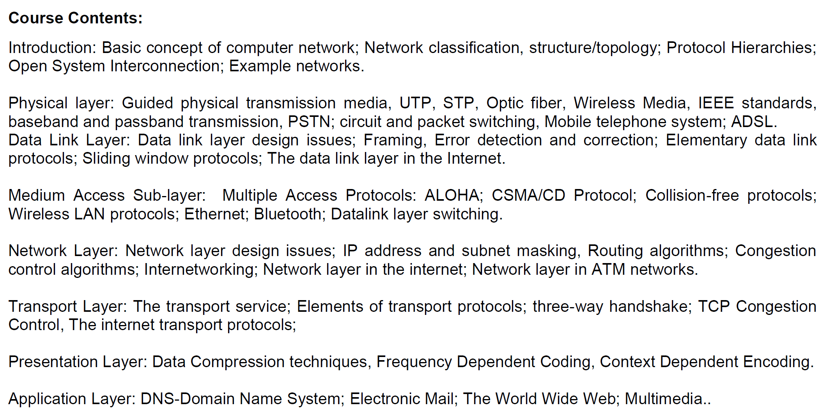

Slide 3
Data Link Layer

Slide 4
The Data Link Layer
The main task of the data link layer is to transform a raw transmission facility into a line that appears free of undetected transmission errors.
It accomplishes this task by having the sender break up the input data into data frames (typically a few hundred or a few thousand bytes) and transmit the frames sequentially.
The receiver confirms correct receipt of each frame by sending back an acknowledgement frame.

Slide 6
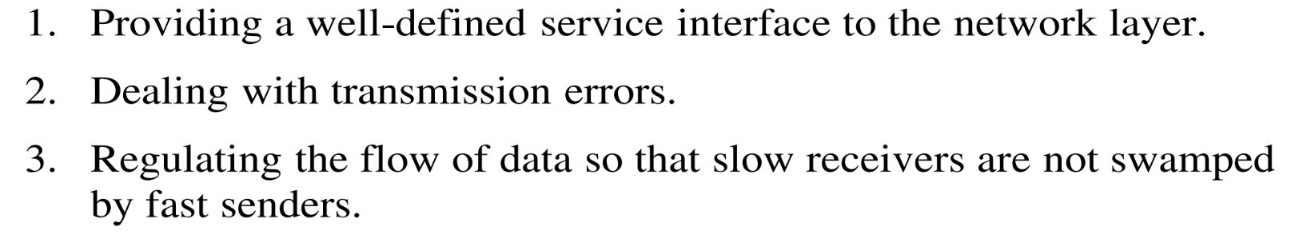
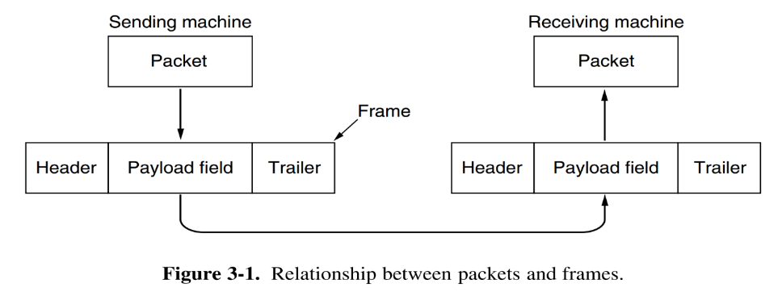
This actual data is called the payload.

Slide 7
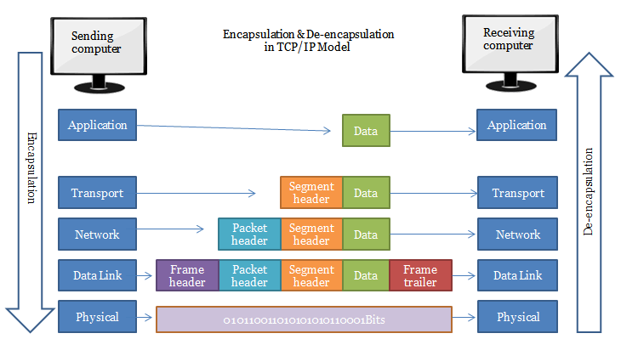

Slide 8
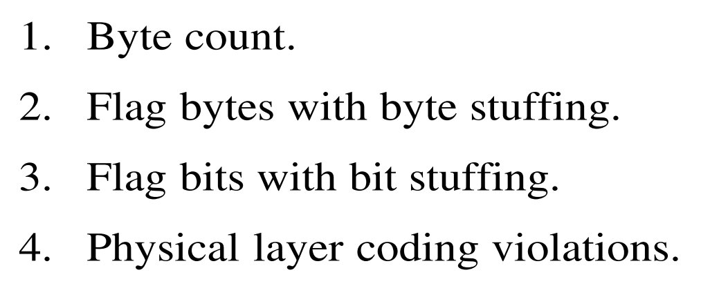

Data Link Layer
Framing:
Breaking up the bit stream into frames
Four methods – very popular

Slide 9
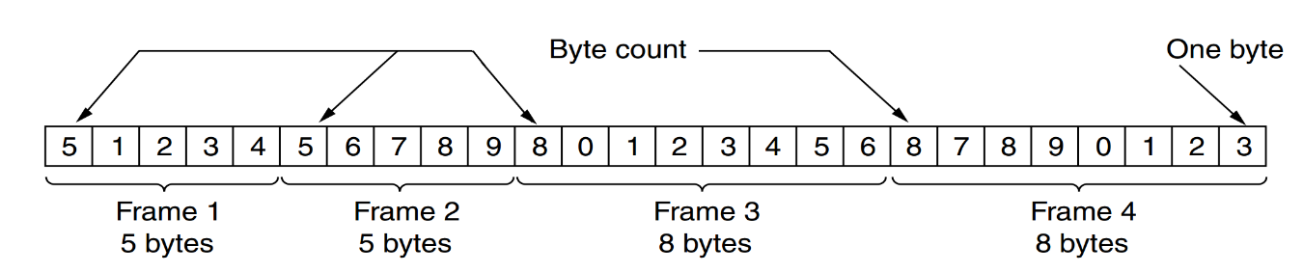
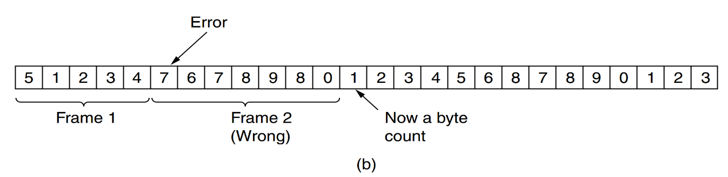
Byte Count

Slide 10
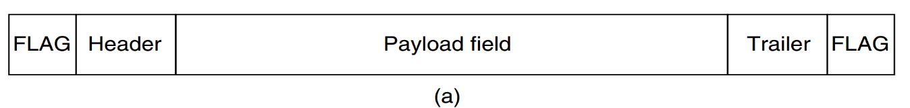
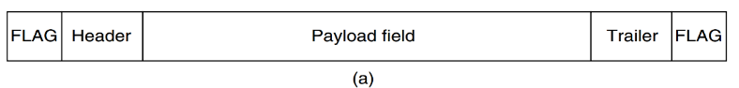
Flag Byte with Byte Stuffing
Flag Byte with Byte Stuffing
Two consecutive flag bytes indicate the end of one frame and the start of the next.

Slide 11
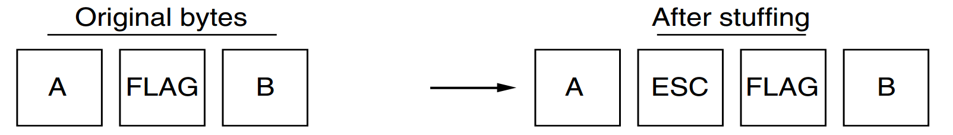
Flag Byte with Byte Stuffing
It may happen that the flag byte occurs in the data.
One …special escape byte (ESC) just before each ‘‘accidental’’ flag byte in the data. This technique is called byte stuffing

Slide 12
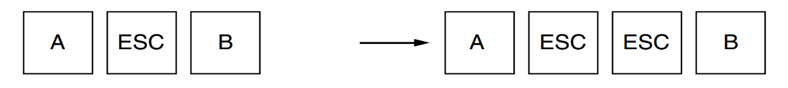

Slide 13
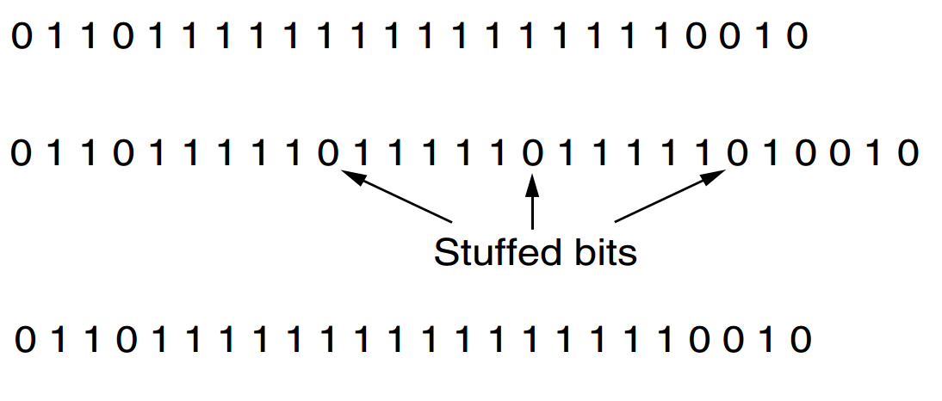
Flag bits with bit stuffing
Each frame begins and ends with a special bit pattern, 01111110 or 0x7E in hexadecimal.

Slide 14
Data Link Layer

Slide 15
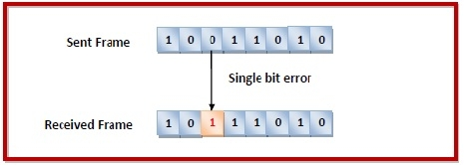
Errors
Types of Errors
Errors can be of three types, namely
single bit errors,
multiple bit errors, and
burst errors.

Slide 16
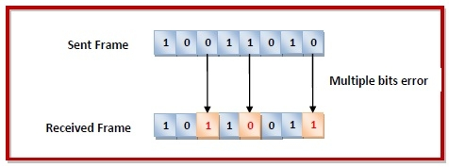
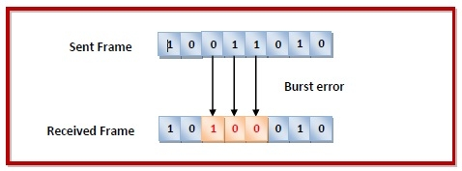
Errors

Slide 17
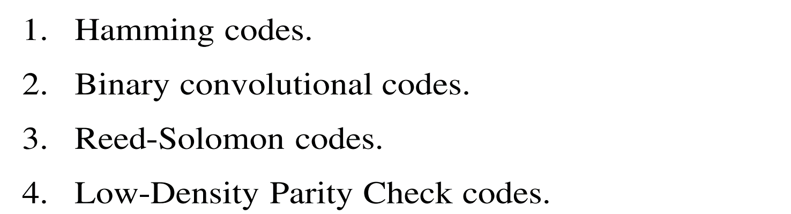
Errors
Error
error-correcting codes and
error-detecting code
Popular error-correcting codes:

Slide 18
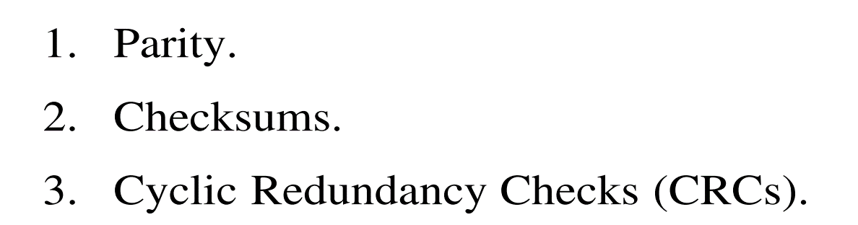
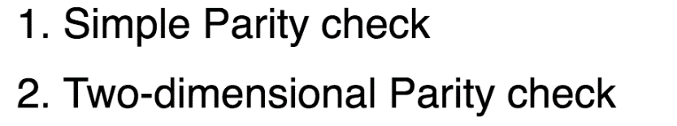
Error Detection
Error Detection

Slide 19
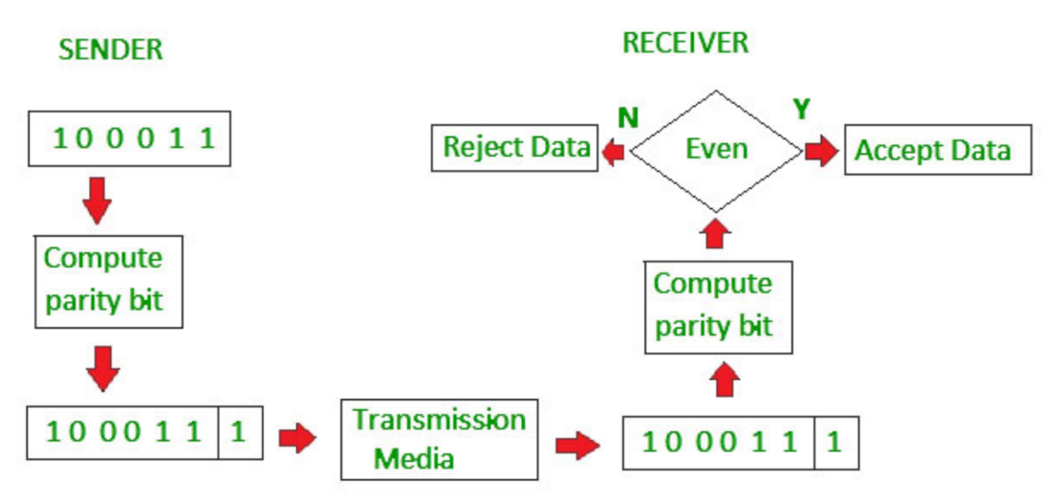
Error Detection
Simple Parity Check

Slide 20
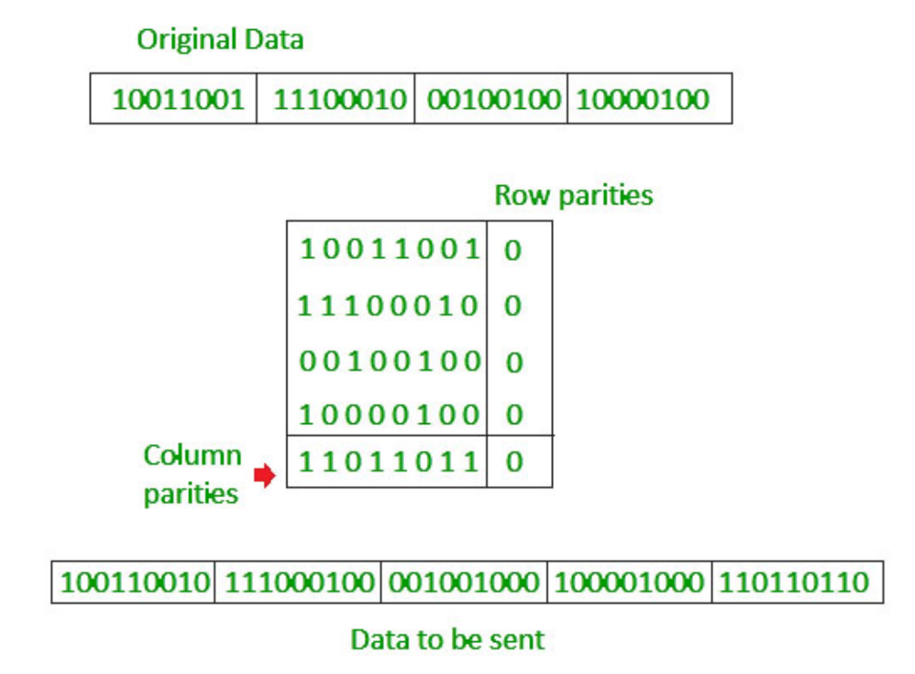
Error Detection
Two Dimensional Parity Check

Slide 21
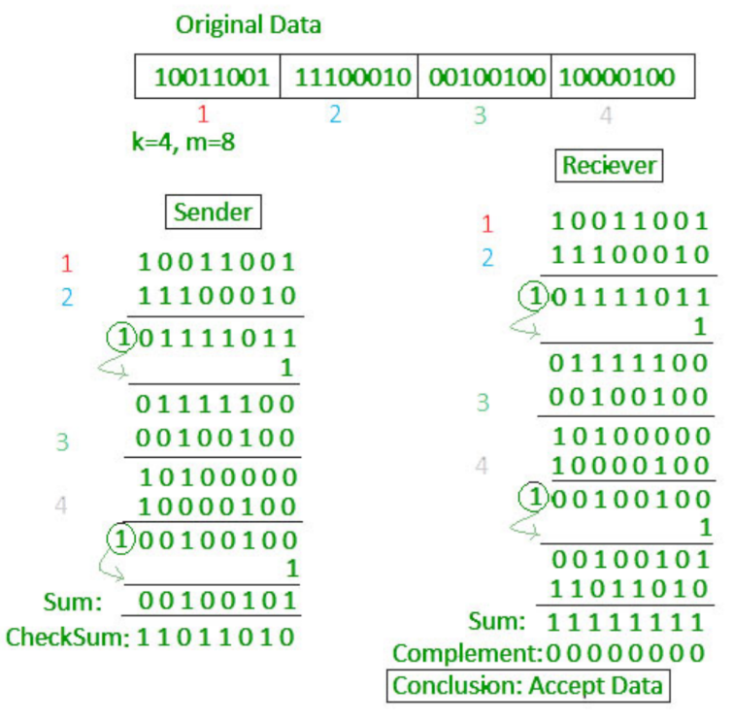
Error Detection
Checksum:
https://www.geeksforgeeks.org/error-detection-in-computer-networks/

Slide 22
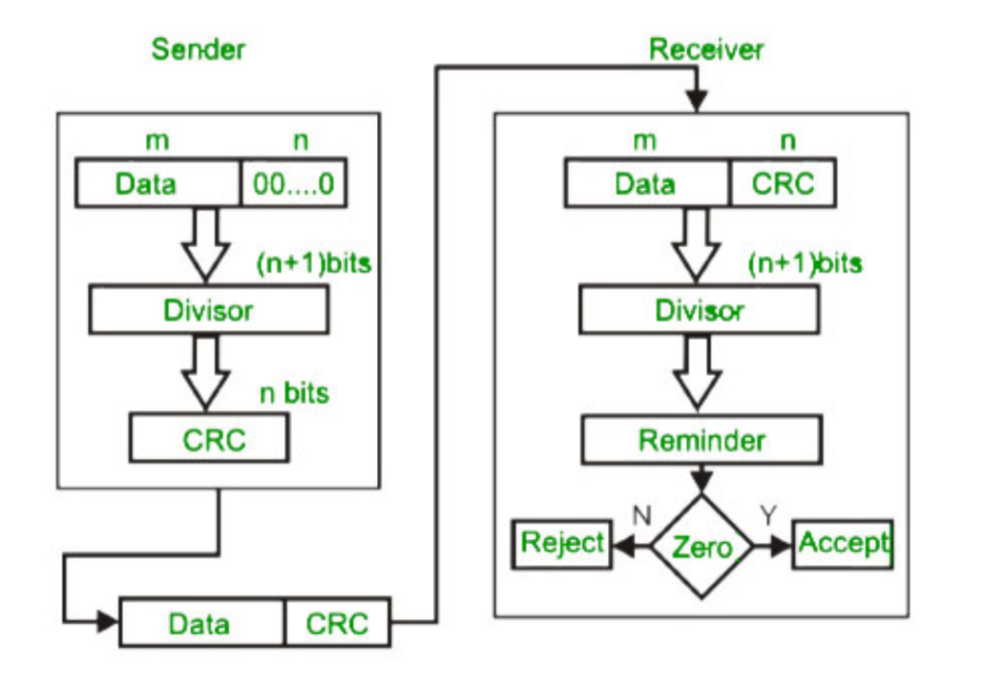
Error Detection
CRC:
https://www.geeksforgeeks.org/error-detection-in-computer-networks/

Slide 23
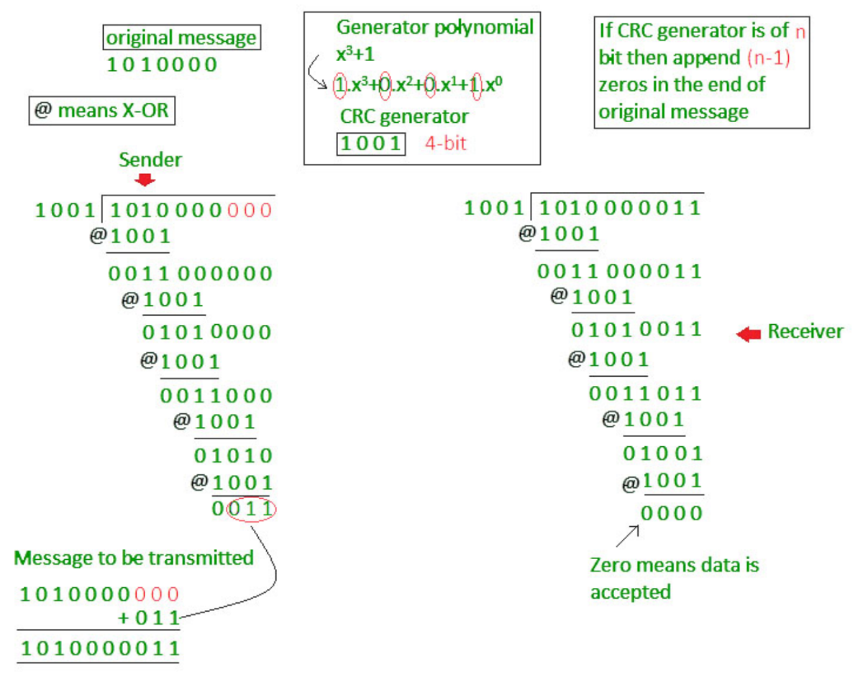

Slide 24

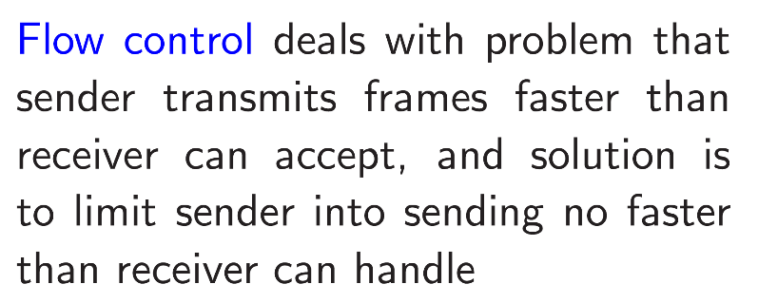
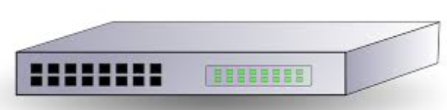
Data Link Layer
Frame –
Flag –
Error Detection and Correction….

Slide 25
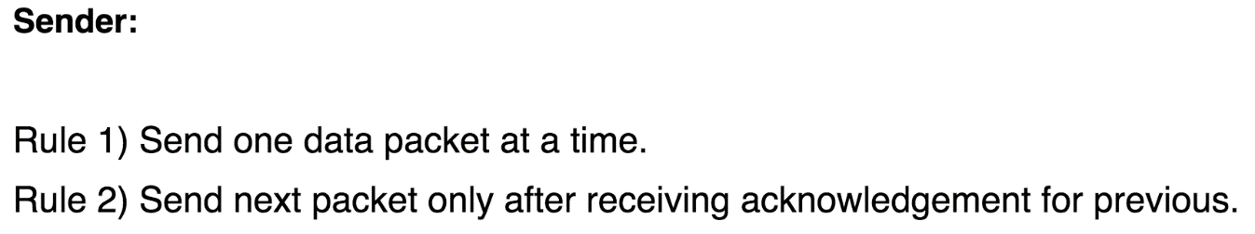
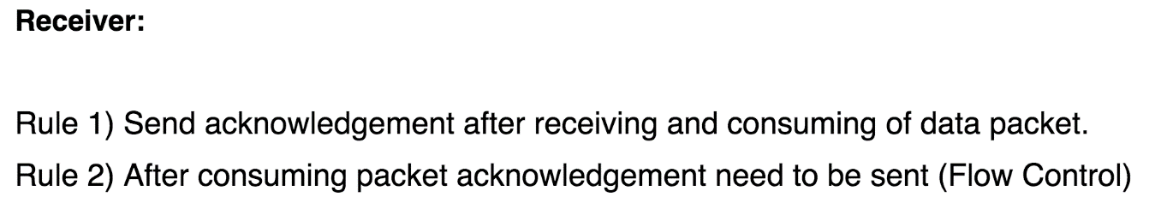
Simple Stop and Wait
Simple Stop and Wait

Slide 26
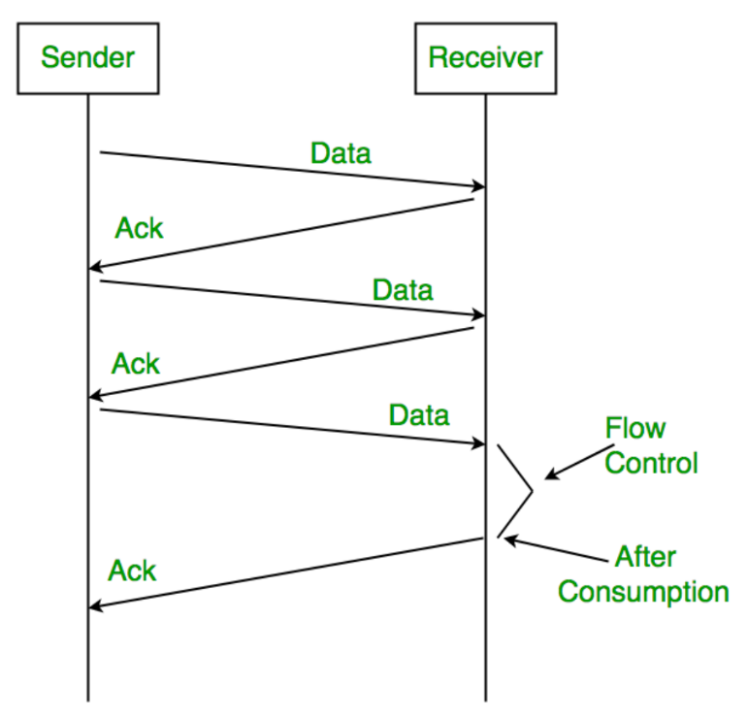
Simple Stop and Wait
Ack/Nak

Slide 27
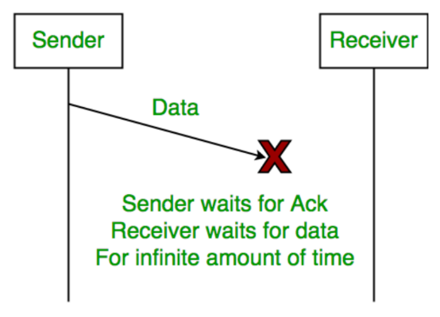
Simple Stop and Wait
#1 Issue:

Slide 28
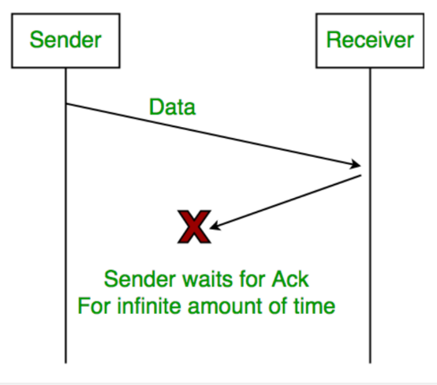
Simple Stop and Wait
#2 Issue:
#3 Issue:
Delayed Acknowledgement/Data: After timeout on sender side, a long delayed acknowledgement might be wrongly considered as acknowledgement of some other recent packet.

Slide 29
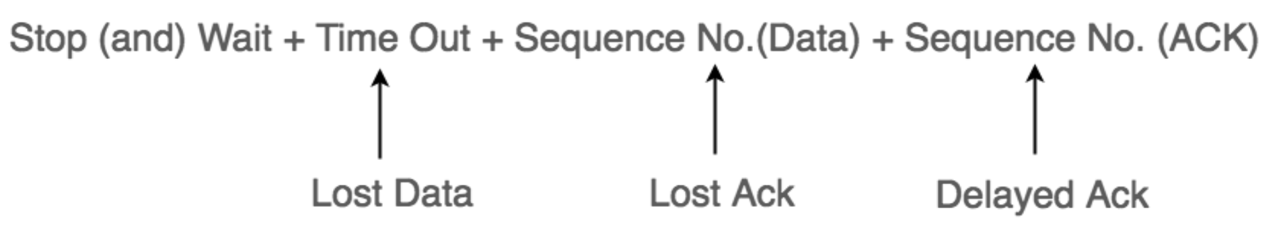
Stop and Wait ARQ
… 3 problems are resolved by Stop and Wait ARQ (Automatic Repeat Request) that does both error control and flow control.
ARQ : Automatic Repeat Request

Slide 30
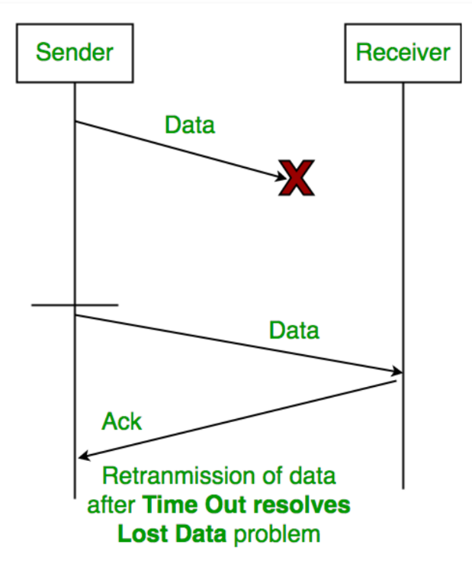
Stop and Wait ARQ

Slide 31
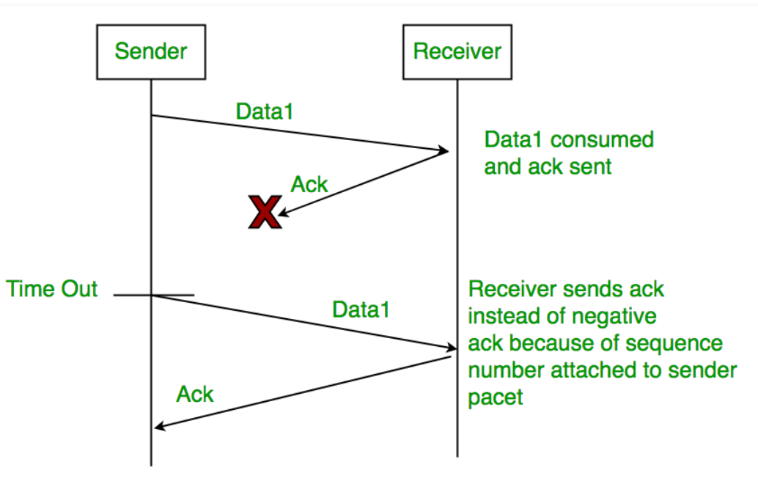
Stop and Wait ARQ

Slide 32
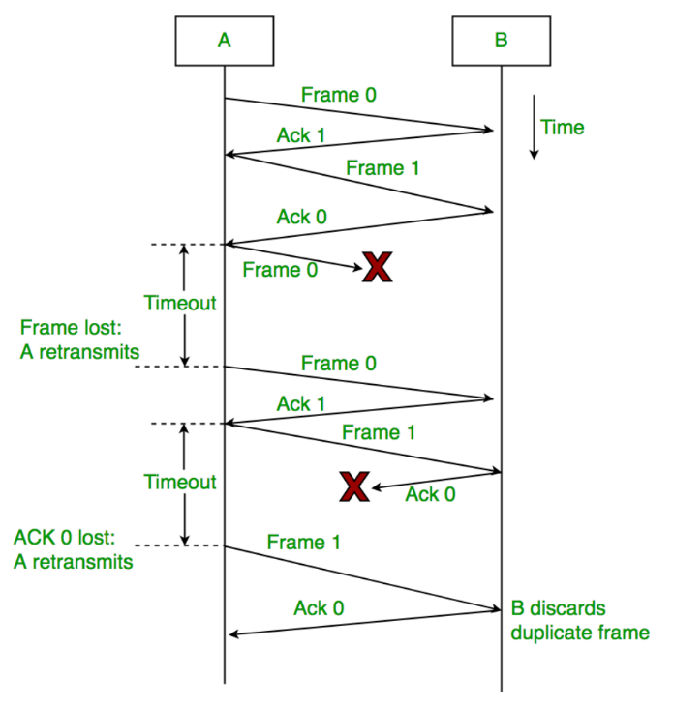
Stop and Wait ARQ
Sender A sends a data frame or packet with sequence number 0.
Receiver B, after receiving data frame, sends and acknowledgement with sequence number 1 (sequence number of next expected data frame or packet)

Slide 33
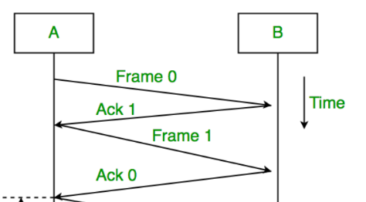
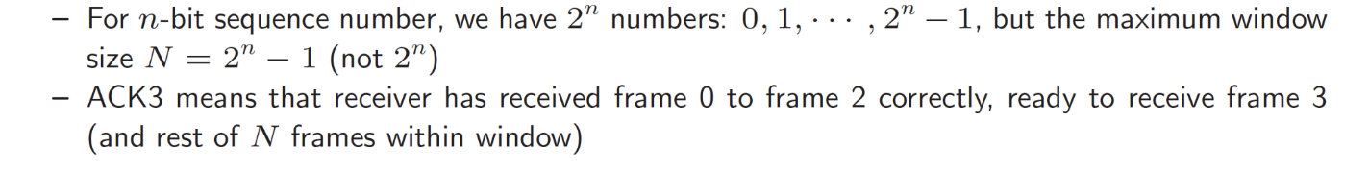
Sliding Window ARQ
Frames and acknowledgements are numbered using Sequence Numbers
Sender maintains a list of sequence numbers (frames) it is allowed to transmit, called Sending Window.
Receiver maintains a list of sequence numbers it is prepared to receive, called Receiving Window.
A sending window of size N means that sender can send up to N frames without the need for an ACK.
A window size of N implies buffer space for N frames.

Slide 34
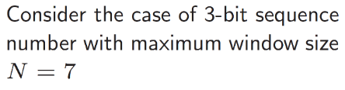
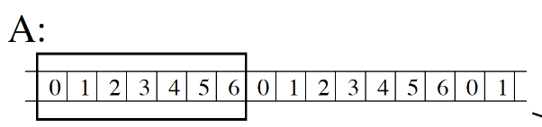
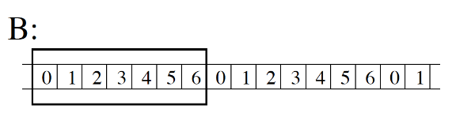
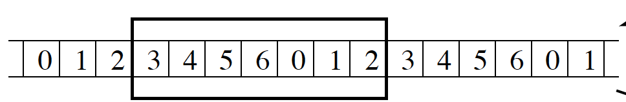
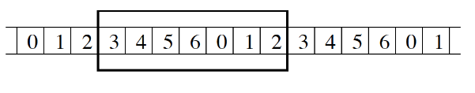
Sliding Window ARQ
ACK3

Slide 35
Sliding Window ARQ
Sliding Window ARQ
Go back N arq
Selective Reject arq

Slide 36
Sliding Window ARQ
Go back N arq
Selective Reject arq

Slide 37
HDLC
HDLC: High-level Data Link Control (HDLC)
High-level Data Link Control (HDLC) is a group of communication protocols of the data link layer for transmitting data between network points or nodes.
Normal Response Mode (NRM)
Asynchronous Balanced Mode (ABM)

Slide 38
HDLC-Transfer Modes
Normal Response Mode (NRM) − two types of stations are there,
a primary station that send commands and
secondary station that can respond to received commands.
It is used for both point - to - point and multipoint communications.

Slide 39
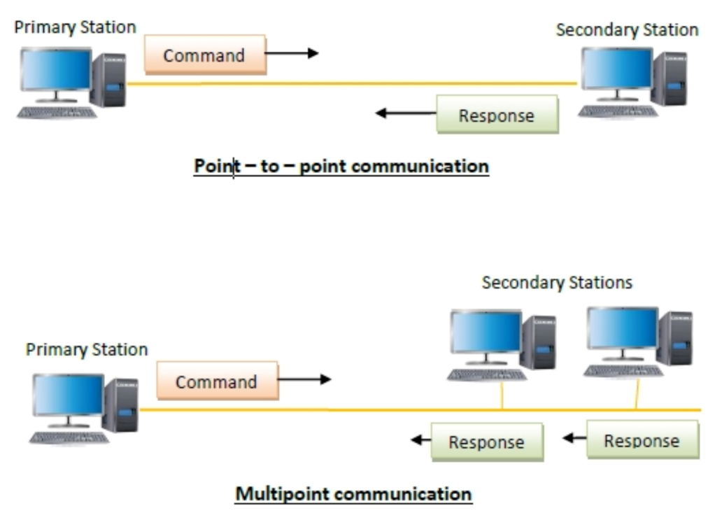
HDLC-Transfer Modes-NRM

Slide 40
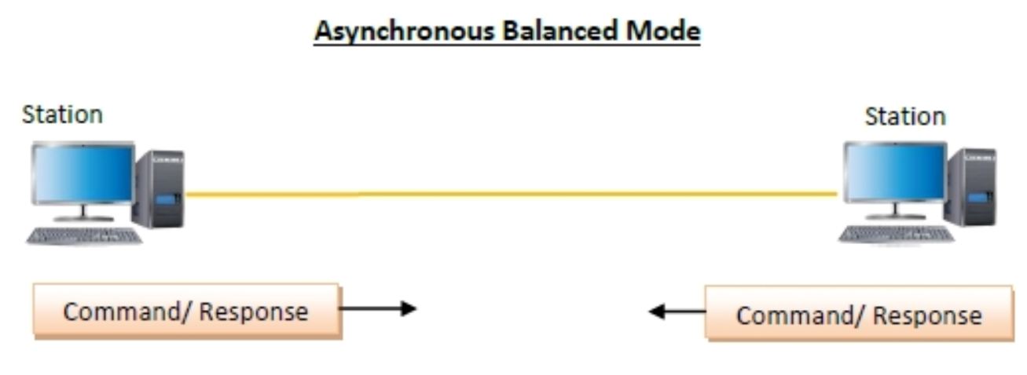
HDLC-Transfer Modes-ABM
Asynchronous Balanced Mode (ABM)
the configuration is balanced, i.e. each station can both send commands and respond to commands. It is used for only point - to - point communications.

Slide 41
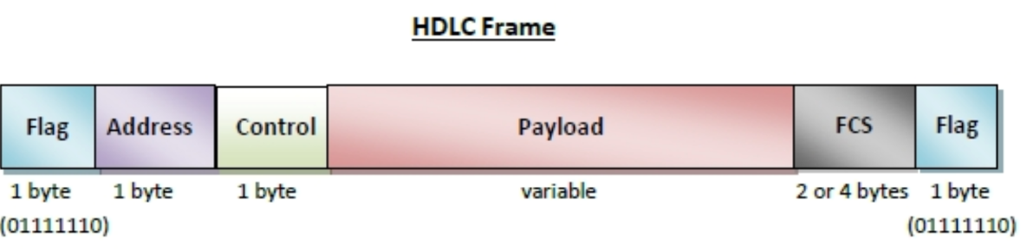
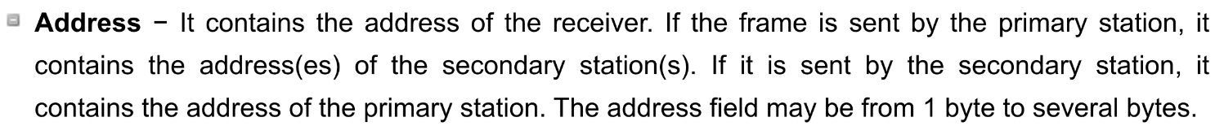
HDLC frame contains up to six fields

Slide 42


Slide 43
Types of HDLC Frames
There are three types of HDLC frames.
I- frame
S- frame
U- frame

Slide 44
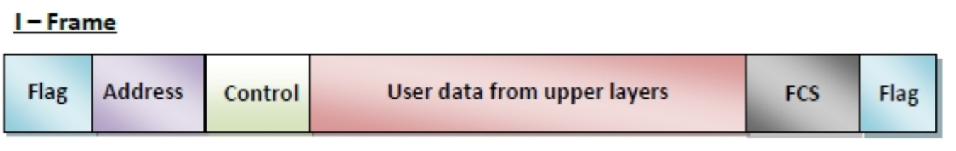
I-frame −
I-frames or Information frames carry user data from the network layer.
They also include flow and error control information that is piggybacked on user data.
The first bit of control field of I-frame is 0.

Slide 45
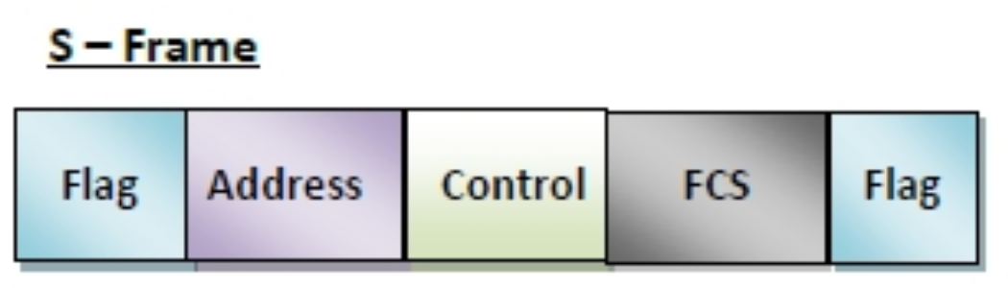
S-frame −
S-frames or Supervisory frames do not contain information field.
They are used for flow and error control ….
The first two bits of control field of S-frame is 10.

Slide 46
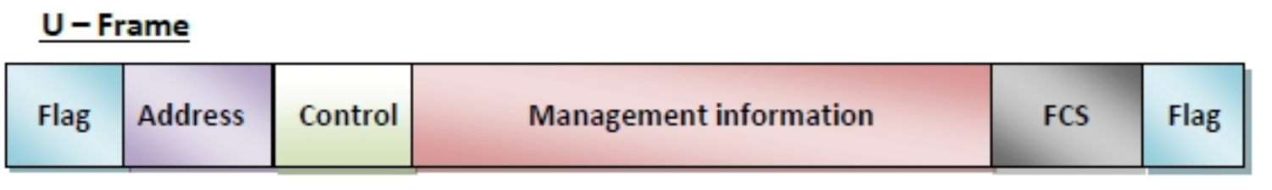
U-frame −
U-frames or Un-numbered frames are used for myriad miscellaneous functions, like link management.
It may contain an information field, if required.
The first two bits of control field of U-frame is 11.
https://www.tutorialspoint.com/high-level-data-link-control-hdlc

